Slide 1
Where’s Our Food?
Supply Chains and Food Security
The International Dimension by Simon J. Evenett

Slide 2
Purpose of this presentation
Contemporary evidence shows:
The rest of the world isn’t threatening U.S. food supply.
If U.S. domestic supply deteriorates further, sourcing abroad is viable.
Key policy implications:
Globalization should be leveraged to mitigate domestic U.S. supply disruption.
By tapping foreign sources of food, the U.S. mitigates the risk of domestic supply chain failure.
Bear this in mind the next time you hear someone argue that:
Foreign suppliers cannot be trusted.
Only domestic suppliers are reliable.

Slide 3
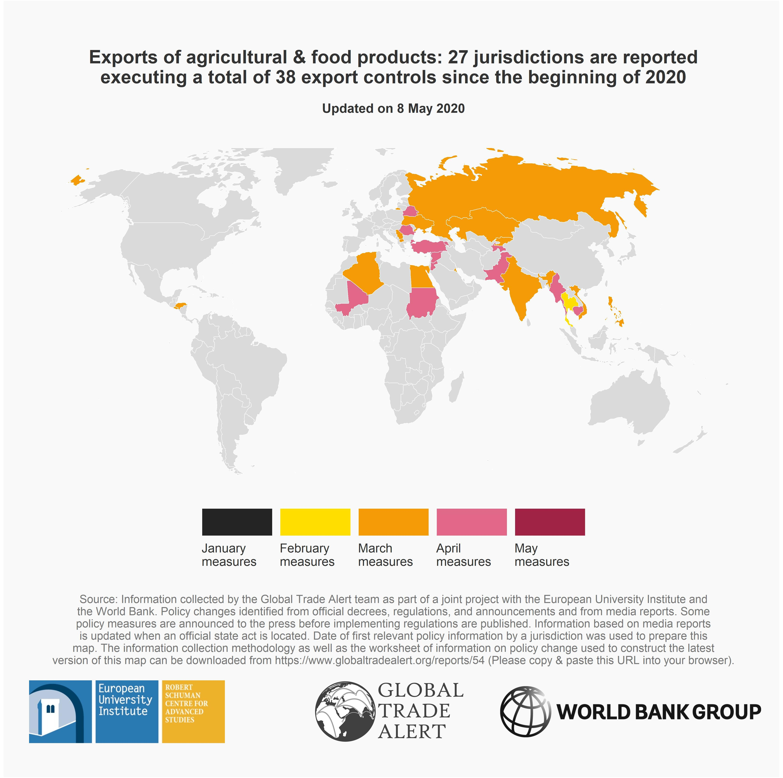
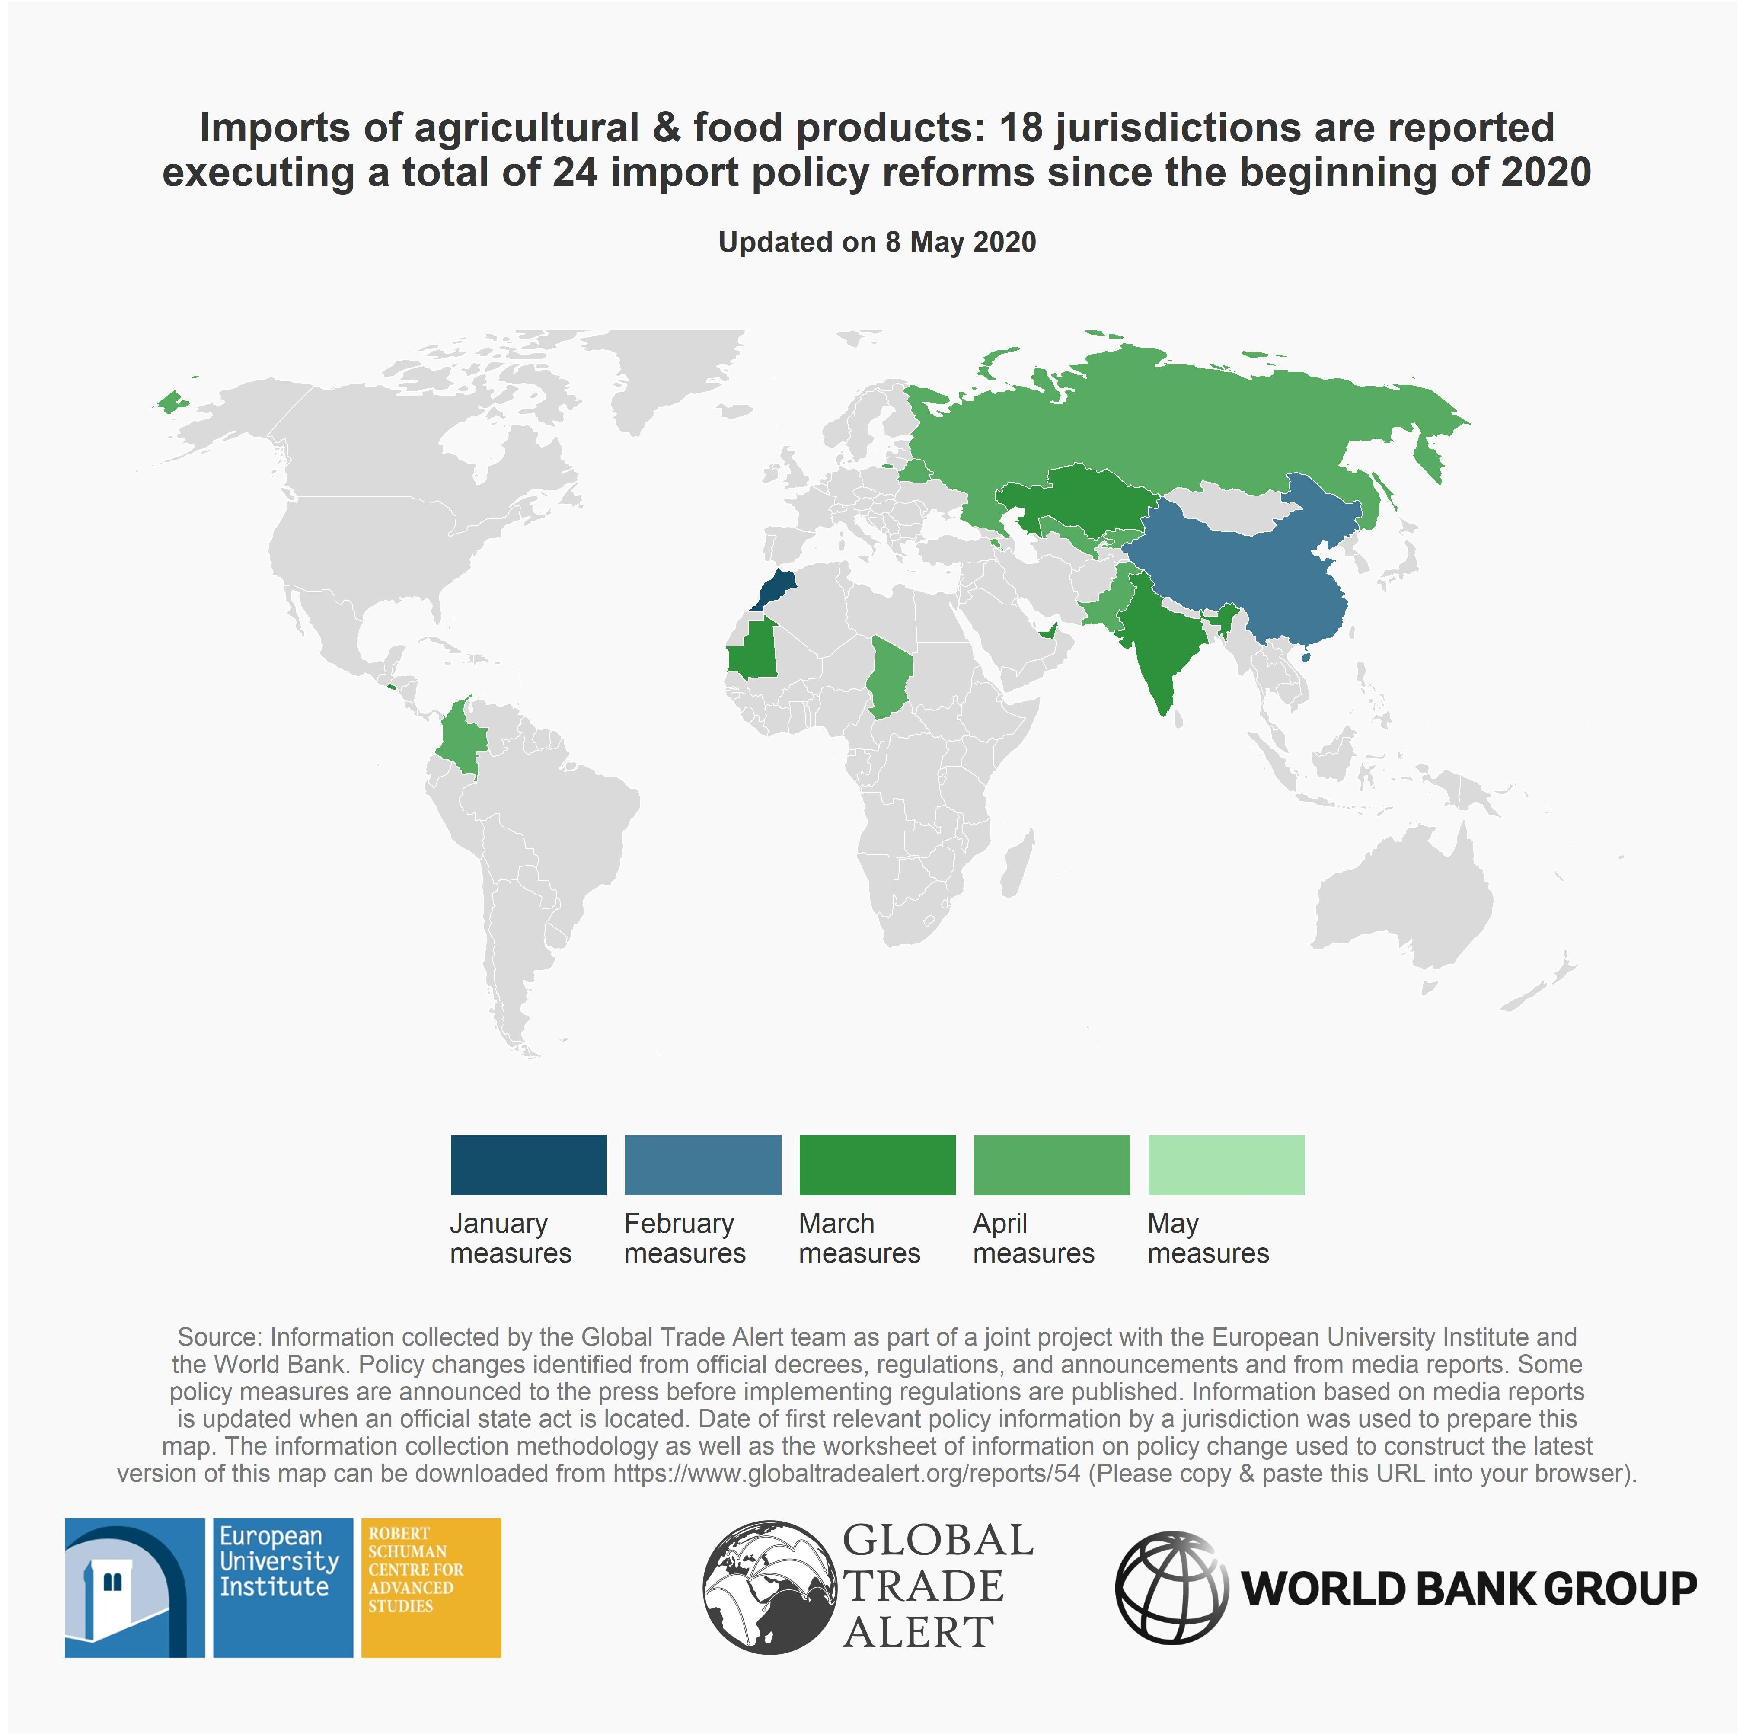
Limited resort to export curbs on food

Slide 4
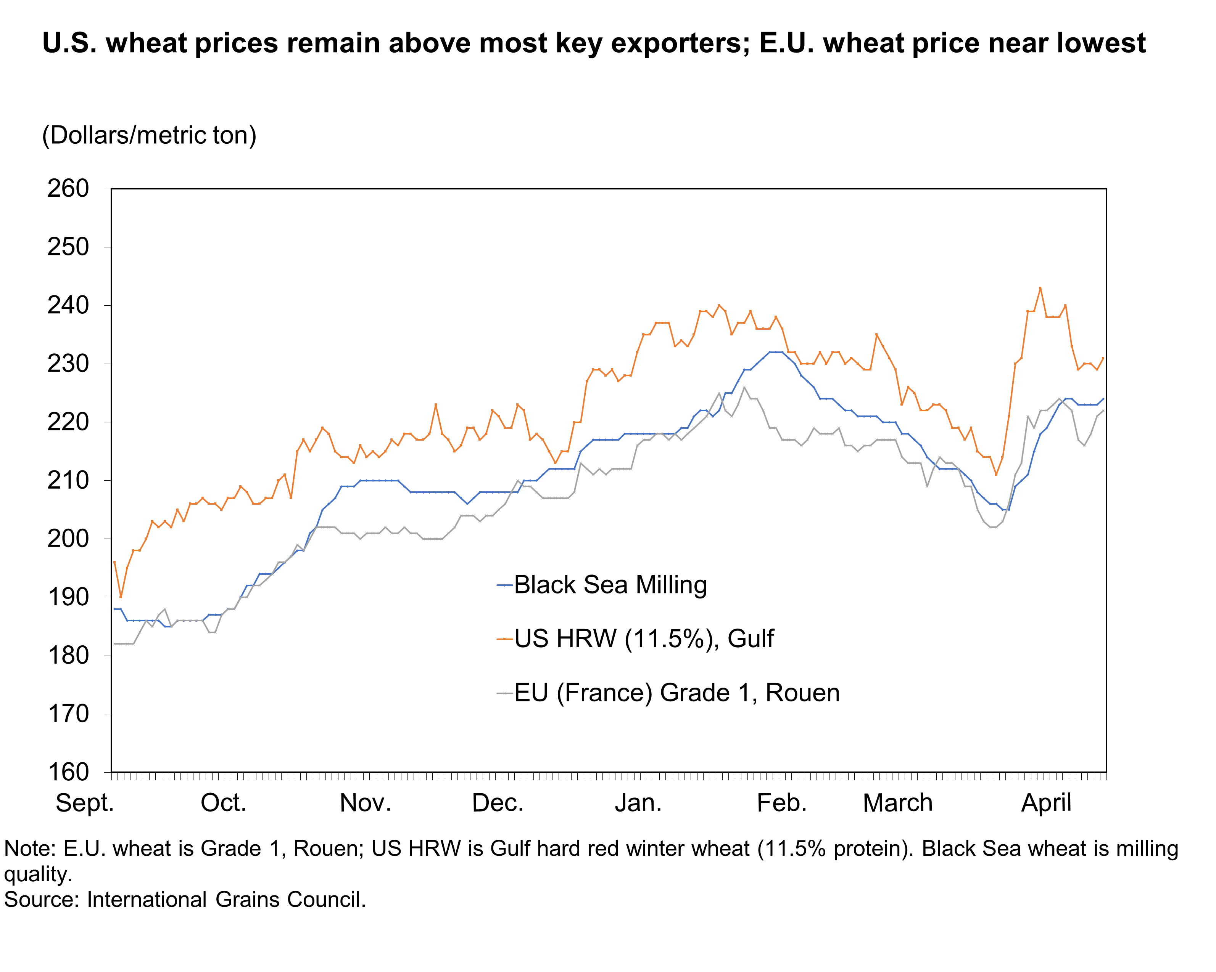
Russia’s export limit on wheat—no price spike
Russia has decided to limit exports of wheat to 7 million metric tons until 30 June 2020.
Expected reduction in supply to world markets: 1.5 million metric tons.
More than made up by higher exports from Australia & European Union.

Slide 5
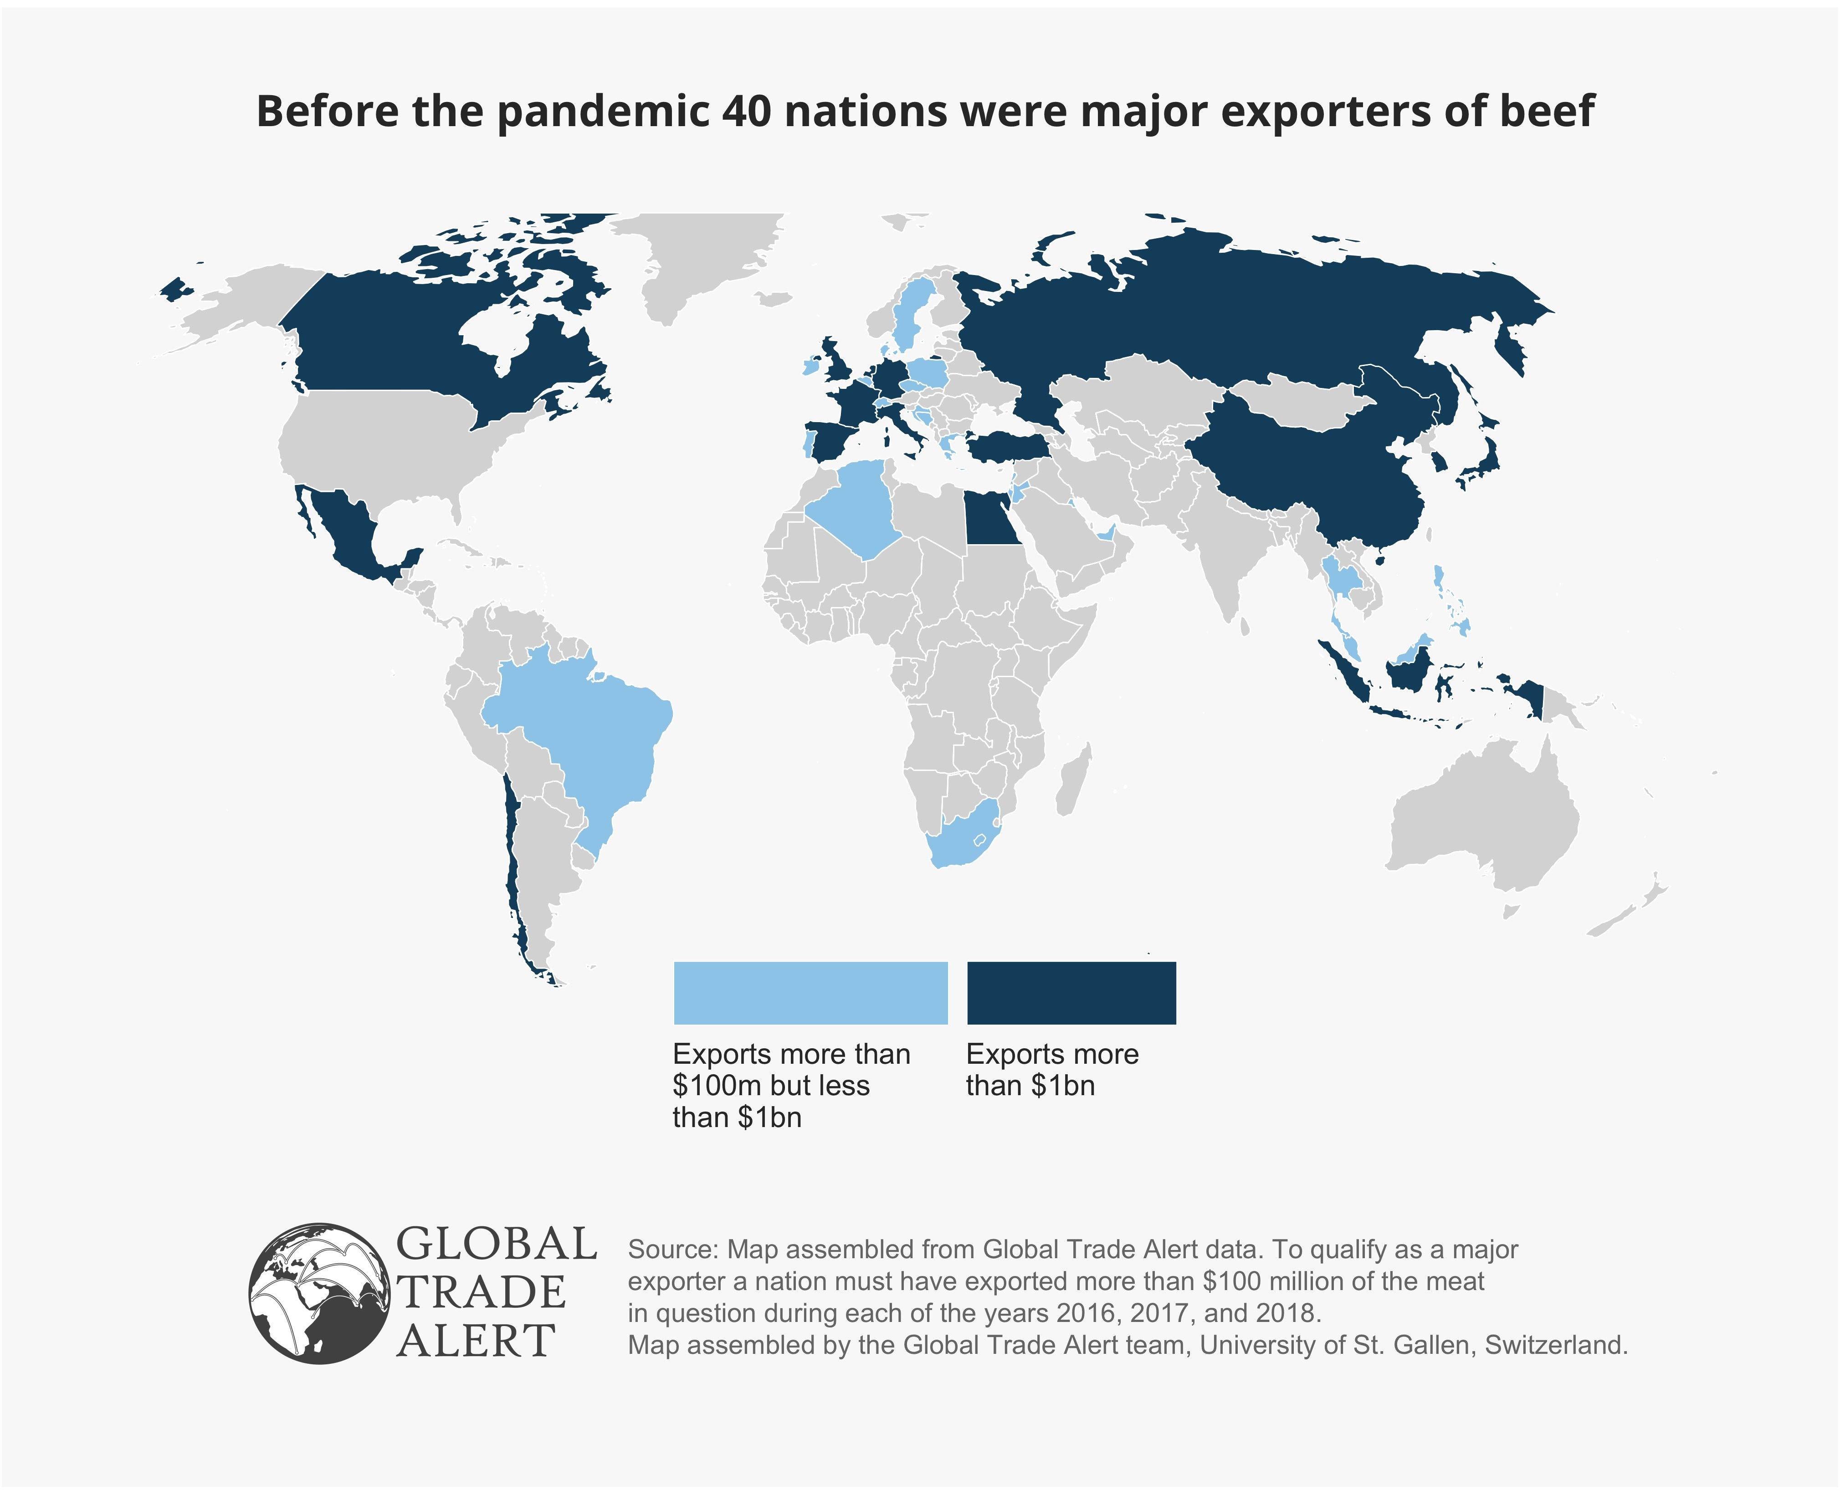
U.S. consumers needn’t suffer if the U.S. food supply chain is disrupted
The U.S. a massive exporter of most meat products—these exports can be diverted to domestic supply.
In addition, the U.S. can source more meat from foreign markets.
The maps on this slide and the next slide show which nations consistently export beef, pork, and chicken.
Like most countries, the U.S. has standards that foreign producers must meet. Not every foreign supplier may be able to do so.

Slide 6
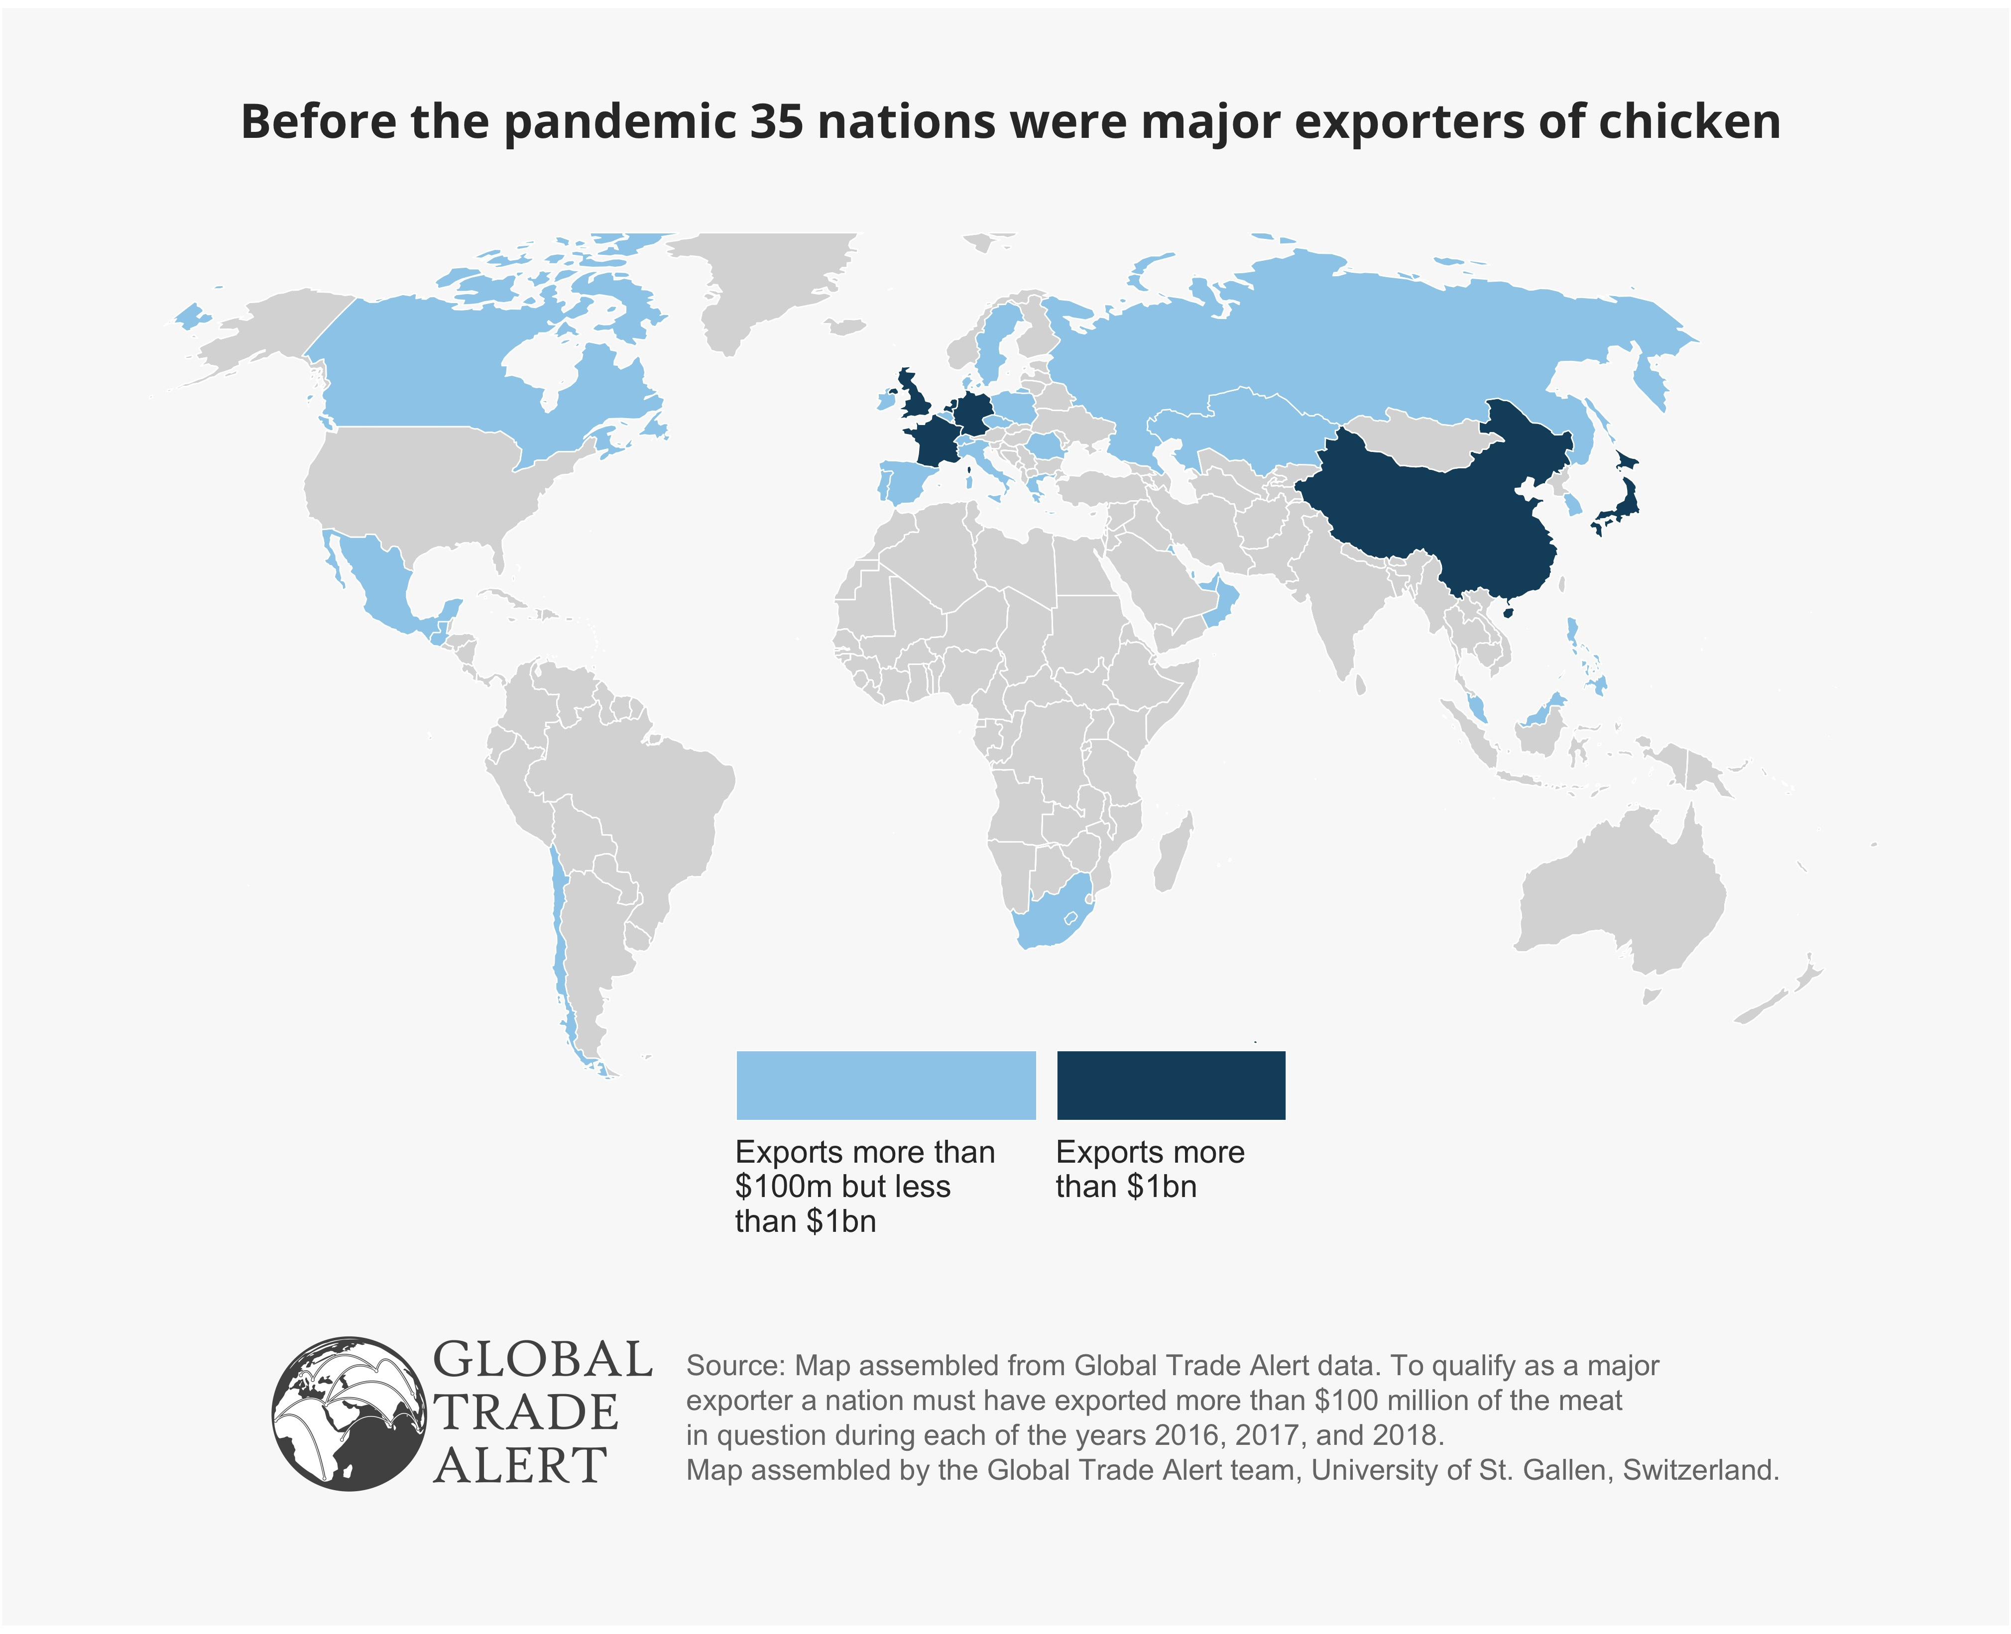
Plus many other nations export pork and chicken as well

Slide 7
Contact information
Professor Simon J. Evenett, University of St. Gallen, Switzerland.
Email: simon.evenett@unisg.ch.
Telephone: +41 71 224 7797.
Analyses of trade policy and the COVID-19 pandemic:
https://www.globaltradealert.org/reports/54
https://www.globaltradealert.org/reports/53
https://www.globaltradealert.org/reports/52
https://www.globaltradealert.org/reports/51
https://www.globaltradealert.org/reports/50
Mentioned in Financial Times, the Economist, Bloomberg, Reuters, CNN, Politico, South China Morning Post etc.
Further information on the Global Trade Alert available at: https://www.globaltradealert.org/about

